Slide 1

Viola Jones Algorithm and Haar Cascade Classifier
Kalybek Aruzhan

Slide 2
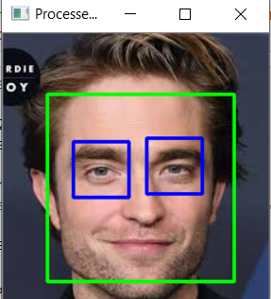
Viola Jones Algorithm
The Viola-Jones algorithm is a machine learning-based object detection method introduced by Paul Viola and Michael Jones in 2001. It became widely known for its real-time performance and high accuracy in face detection.

Slide 3
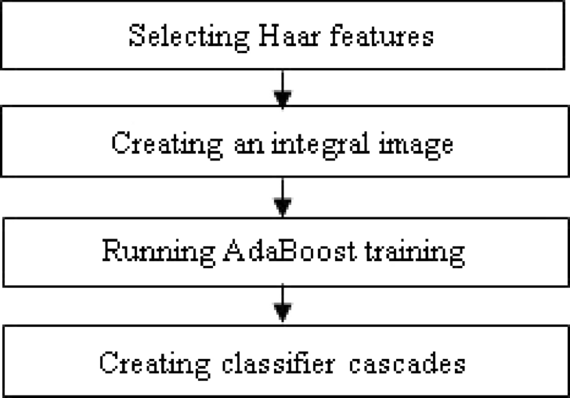
Key steps of algorithm
Haar-like Features are rectangular patterns that compute the difference between the sum of pixel intensities in white and black regions. These features are used to detect patterns like edges, lines, and changes in texture, which are common in objects like faces (e.g., dark eyes vs. bright cheeks).
2. Integral Image. To make feature computation efficient, the integral image is used. It allows rapid calculation of the sum of pixels in a rectangular region. This drastically reduces the time needed to compute Haar-like features.
3. AdaBoost Classifier is used to select the most relevant Haar-like features out of thousands. It combines these features into a strong classifier that can distinguish objects (like faces) from non-objects.
4. Cascade of Classifiers. Instead of applying all features to every image region, the algorithm uses a cascade of classifiers. Each classifier focuses on rejecting negative regions quickly (regions without the object of interest) and passing positive regions to the next stage for more detailed checks. This design makes the detection both fast and accurate.

Slide 4
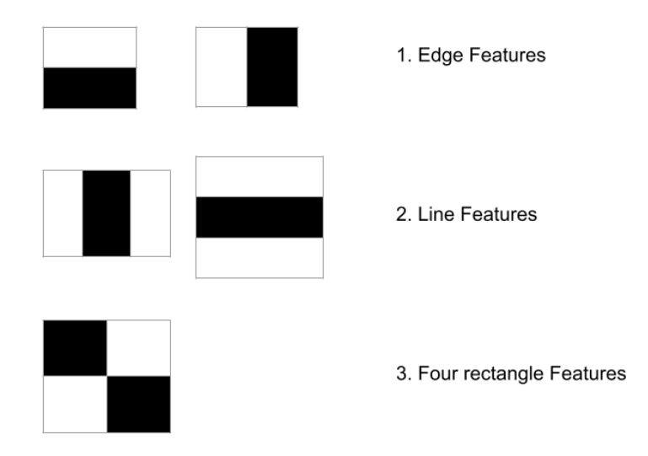
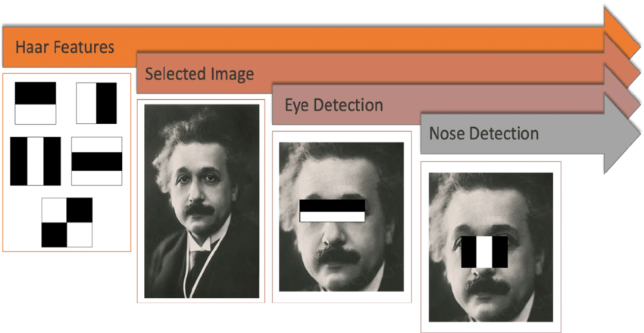
Haar-like Features
Haar-like Features are simple patterns used to detect objects in images by analyzing the difference in brightness between dark and light regions. Named after the mathematician Alfred Haar (1909), they are a core component of the Viola-Jones Algorithm for object detection.
Haar-like Features are rectangular patterns that compare the intensity (brightness) of light and dark areas in an image. For example:
Dark eyes against a lighter forehead.
The light bridge of the nose between darker sides.

Slide 5
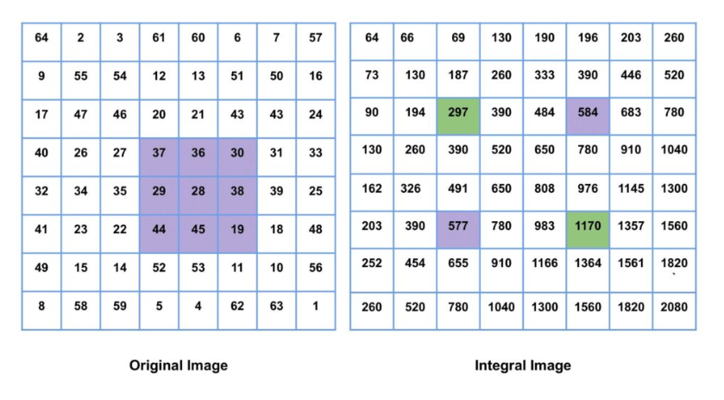
Integral Image
Imagine we’re working with an image, and you want to quickly figure out how "bright" a certain part of it is (like a rectangle area). Normally, we’d add up the brightness of every pixel in that rectangle one by one, which can take forever if the image is big.
Integral Image is like a cheat code: it lets you get the total brightness of any rectangle in the image almost instantly.
An Integral Image is like a magic map of the picture, where every pixel doesn’t just show its brightness, but also adds up the brightness of everything above and to the left of it.
Why is it awesome?
It makes algorithms like Viola-Jones crazy fast.
We can analyze big images without wasting time.
The sum of all purple boxes in the original image is equal to the sum of green boxes in the integral image subtracted by the purple boxes in the integral image.

Slide 6
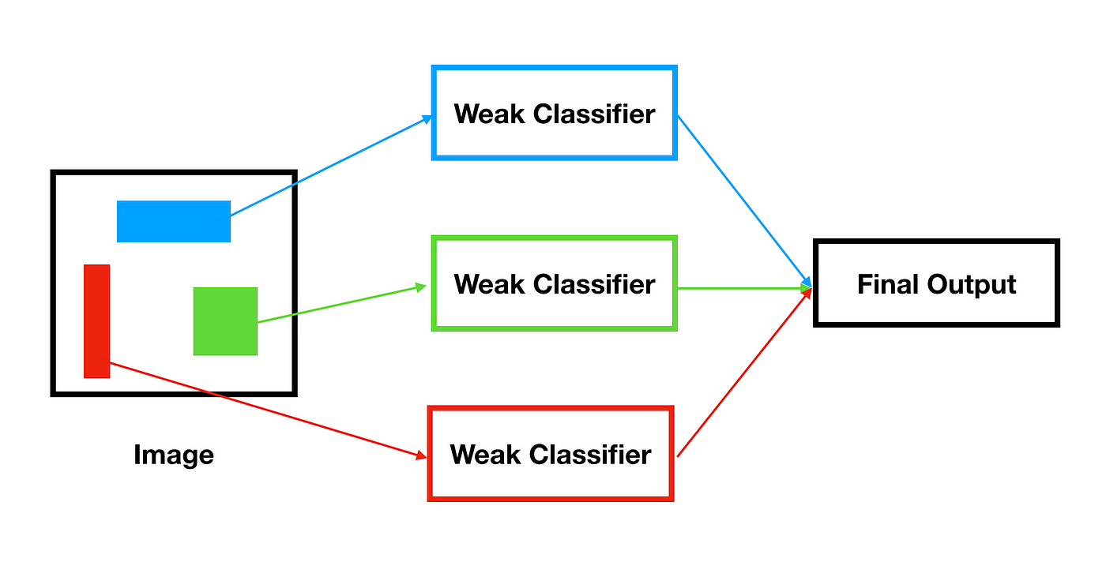
Adaboost Classifier
The AdaBoost Classifier plays a crucial role in the Viola-Jones Algorithm for object detection. It’s the mechanism that selects the most important features and combines them into a strong classifier to detect objects (like faces) effectively.
AdaBoost is a machine learning algorithm that creates a strong classifier by combining many weak classifiers. In the Viola-Jones Algorithm, each weak classifier is based on Haar-like Features.
AdaBoost in the Viola-Jones Algorithm is the "brain" that selects the best Haar-like features and combines them into a powerful classifier.

Slide 7
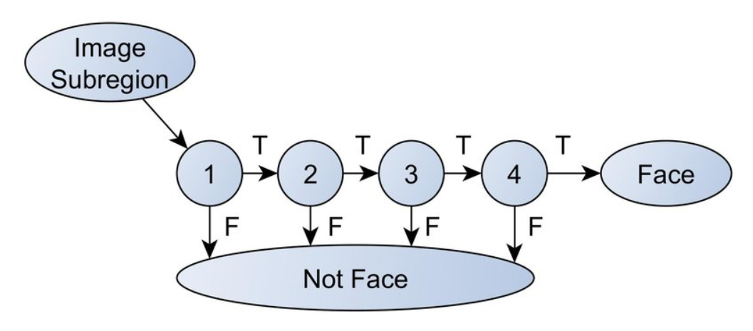
Cascade of Classifiers
The Cascade of Classifiers is a key concept in the Viola-Jones Algorithm. It’s a structure that organizes multiple classifiers in a sequential pipeline to quickly and efficiently detect objects in an image.
The cascade works like a filtering system:
Quickly rejects non-object regions (areas without a face).
Focuses more effort on regions that might actually contain the object.

Slide 8

Advantages Disadvantages
+ The cascade structure enables rapid detection.
+ Well-trained classifiers can achieve high accuracy.
+ Suitable for live applications like face detection in webcams.
- If the face is tilted or the lighting is bad, the algorithm is like this: "Oh, I'm not sure if this is a face..."
- This is already an old method — now neural networks, such as deep learning, make it cooler.

Slide 9
Summary
The Viola-Jones algorithm is a general process that explains how to find objects.
Haar-like features (the basis of the classifier) were invented much earlier, back in the 1910s.
The Haar classifier, which uses these features to analyze images, was introduced by Viola and Jones as part of their algorithm.
The Viola-Jones algorithm appeared in 2001 and became the first full-fledged system that connected everything together: Haar features, cascades, integral image and AdaBoost.
The Haar classifier is a tool inside the Viola—Jones algorithm that uses Haar features.

Slide 10
Thanks for attention!

